Slide 1
Ekphrastic
Poetry through visual representation

Slide 2
An ekphrastic poem is a vivid description of a work of art. In other words it is a poem inspired by a work of art.
Ekphrasis means “description” when translated in Greek. In ancient Greece the term was applied to the skill of describing a thing with vivid detail.
Ekphrastic has the ability to enhance the original artwork and take on a life of its own. You are making art inspired by a different artform.

Slide 3
Ekphrasis is a way of bringing the experience of an object to a listener or reader through highly detailed descriptive writing.
It can be a way to share the emotional experience and content with someone who has never encountered the work in question.
It is good to embody qualities beyond the physical aspects of the work, think about an emotional connection or overlaying theme to a specific written work.
Welsh, Ryan. "Ekphrasis." Ekphrasis. The University of Chicago, n.d. Web.

Slide 4
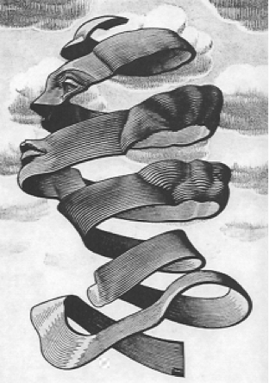
Rind Catherine A. Callaghan (1999)
The critic
Resolved her sonnects
Into empty feet.
The boss
Rejects proposals
He has barely skimmed.
The husband
Compares her pilaf
To swill for hogs.
The gas
She hopes will klll her
Leaks away.
The analyst
Unpeels her
Till she disappears.
M.C. Escher

Slide 5
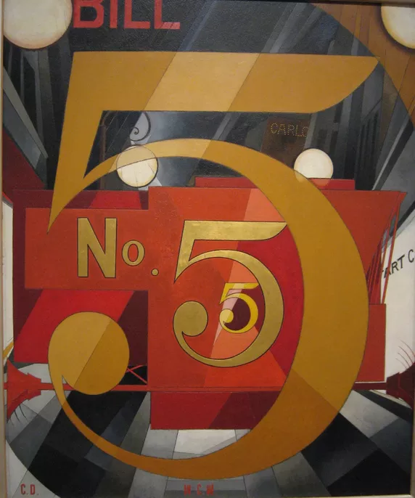
The Great Figure
-William Carlos Williams
Among the rain
And lights
I saw the figure 5
In gold
On a red
Firetruck
Moving
Tense
Unheeded
To gong clangs
Siren howls
And wheels rumbling
Through the dark city.
Charles Demuth
Figure 5 in Gold
1928
Example of Painting depicting a poem

Slide 6
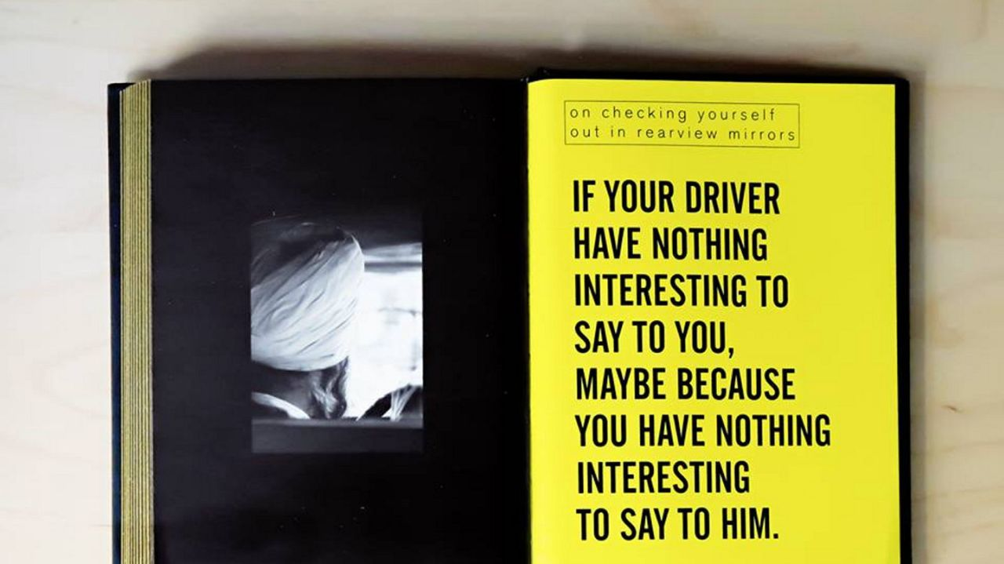
From “Taxi Driver Wisdom” Risa Mickenberg (Author) and Joanne Dugan (photographer)

Slide 7


Slide 8
“I am taking an existing work of art and rewriting over it. I’m imposing a new narrative on it, one that is partially suggested by the artwork itself and partially by something that comes from within. Sometimes that thing is an autobiographical moment, sometimes it’s a larger concern, social or political or intellectual.”
-Mary Jo Bang when talking about her
own approach to ekphrastic poems

Slide 9

Let’s try one together:
There is Another Sky by Emily Dickinson
There is another sky,
Ever serene and fair,
And there is another sunshine,
Though it by darkness there;
Never mind faded forests, Austin,
Never mind silent fields -
Here is a little forest,
Whose leaf is ever green;
Here is a brighter garden,
Where not a frost has been;
In its unfading flowers
I hear the bright bee hum:
Prithee, my brother,
Into my garden come!
**Think about visually representing something using the terms and techniques we’ve learned in class**

Slide 10
Terms and techniques to keep in mind:
Composition (Rule of Thirds)
Depth of Field (small or large aperture)
Subject Matter
Texture (Elements and Principles of Art)
Motion (Shutter Speed)
Special Effects

Slide 11
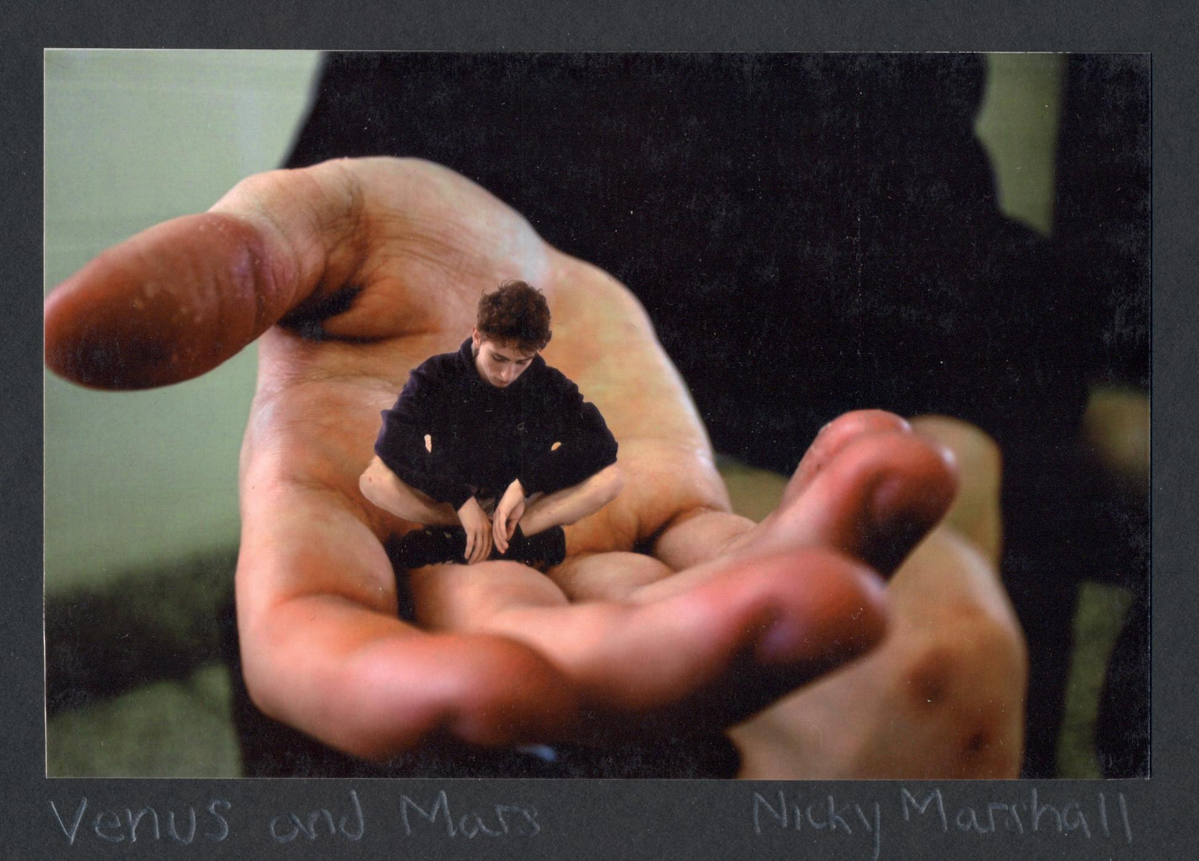
Student Examples:
“Venus and Mars”
She lured him in with
Her sexual prowess
And loved him
Above the tall grass,
And
Under the tall oaks.
Though after he
Drifted into the heavens,
She brought in her daemons
And let them steal from his soul.
They took his mind,
His memories,
His love,
His drink,
His wealth,
And his heart.
All that he has been,
All that he is,
All that he will be,
Is now hers
For the taking.

Slide 12
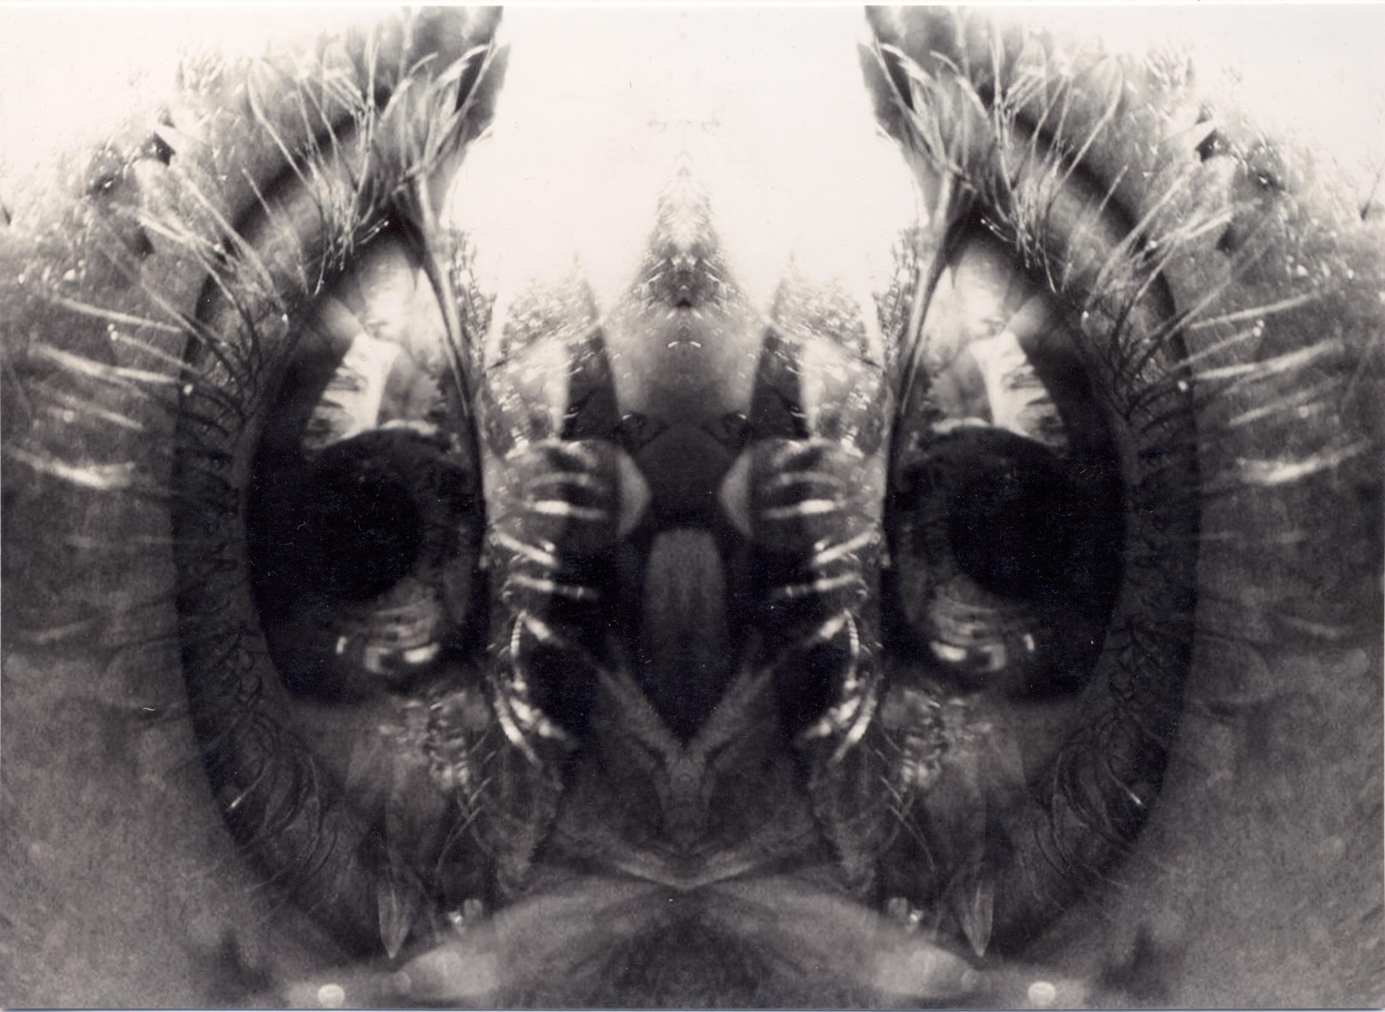
“Reflection”
You see my beauty when I cannot, to you I am perfect,
You make me chuckle and i think aloud, how lucky you are to be a man!
You appear oblivious to your own personal insecurities the stereotypes of men I suppose
You are able to be ready in minutes, as you do not worry about perfection.
It takes me hours to get ready, i stare in the mirror.
I see a clear image of the final result but it does not happen;
My face, my hair, does not match the image in my mind, about ready to give up, realizing perfection will never be achieved.
God help me, see my beauty i know i have when i look in the mirror!
About ready to give up i start to realize, i have already achieved that perfect beauty
Reassurance washes over me and you, i can see my beauty finally my outward self, radiates the beauty from
Within, calming and majestic, radiant like the effect of becoming enchanted by the sunset.

